Slide 1


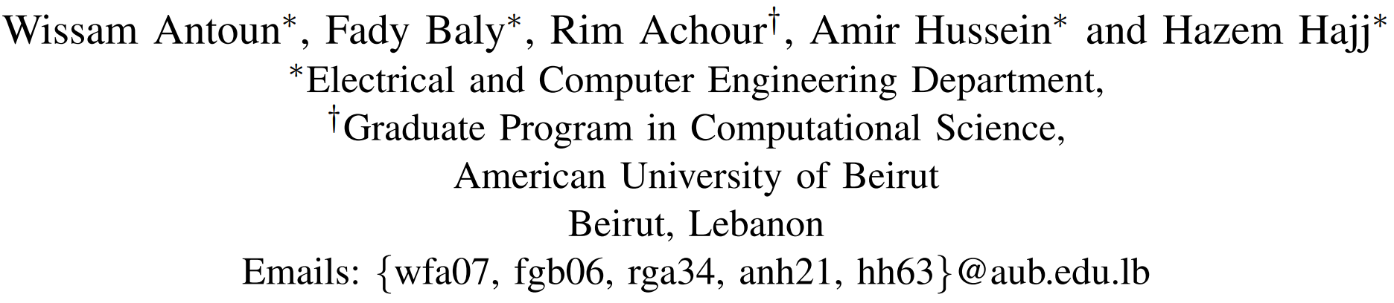
State of the Art Models for Fake News Detection Tasks
GitHub repo:

Slide 2
Outline
Introduction
Related Works
Proposed Method
Experiments and Evaluation
Results
Future Works

Slide 3

Introduction

Slide 4
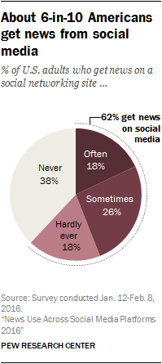
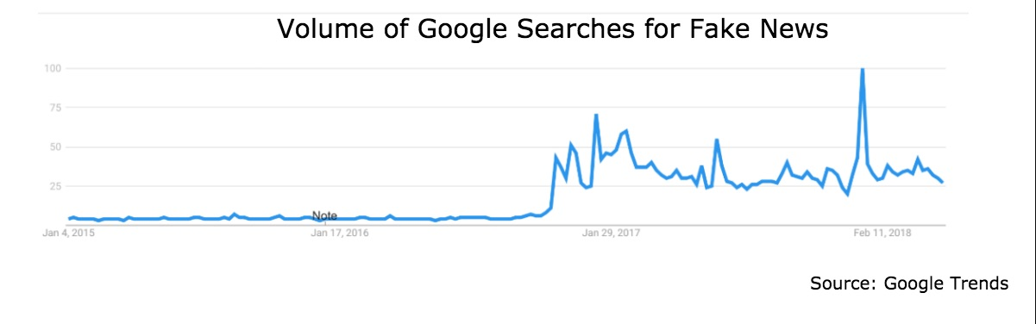
Introduction
What is fake news: stories or hoaxes created to deliberately misinform or deceive readers (influence people’s views, push a political agenda or cause confusion, etc.)
Importance:
Hot topic since 2017, weaponized to harm
Many people get news from social media sites
75% of young people aged 15-24 do not recognize fake news [1]
Create social bots to spread false stories
Notes:
Introduction about the competition challenges
What is Fake news and what are social bots? why tackling these challenges is important?

Slide 5
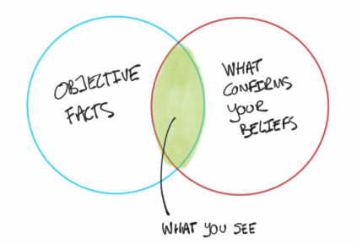

Fake news is very challenging
Difficult to identify credibility of the story
Author credibility
Biased information
Date of publishing
Writing style
Other indicators of quality
Notes:
Author Credibility: Does the author have the credentials, academic background, or experience to write authoritatively about the topic
Biased Information: is it designed to persuade the reader? Maybe it only presents part of the whole story?
Date of publishing: Information in some areas change, and hence it needs to be up-to-date
Writing style: For example usually Fake news packs the main claim of the article into its title
Indicators of Quality: are claims backed up by credible resources?

Slide 6
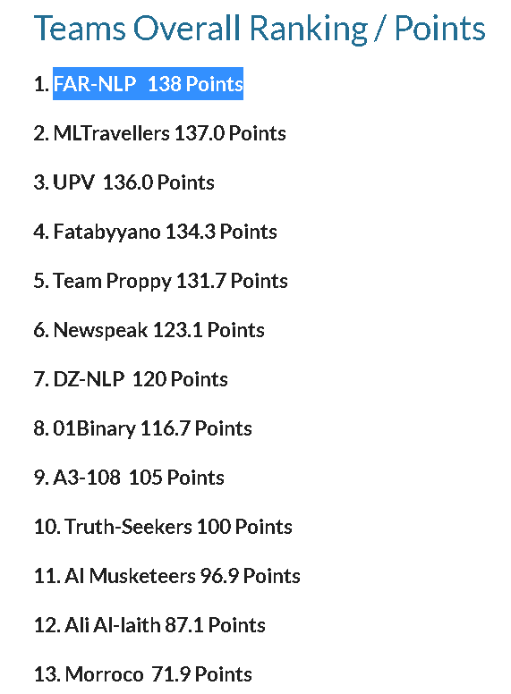
Fake News Contest
Qatar International Cybersecurity Contest (𝐐𝐈𝐂𝐂) , Fake News Detection
Fake news and disinformation is a cybersecurity threat
Requiring cutting-edge and adaptive solutions
Organized by the College of Humanities and Social Sciences
+130 participants representing 30 countries
There are 3 tracks in the contest:
Track 1-A: Building a machine learning model to detect fake news and the news domain.
Track 1-B: Building a machine learning model to detect if a Twitter account is a Bot or Human
Track 2 : Collect and annotate a Fake News Corpus
Notes:
Introduction about the competition challenges
What is Fake news and what are social bots? why tackling these challenges is important?

Slide 7
Problem Statement
Fake news and news domain detection:
Twitter Bots:
Business
Fake
Breaking News: Snapchat to purchase Twitter for 255 billion
Yahoo and AOL could be extremely popular over the next decade and revenues are expected to …
Education
Entertainment
Legit
Politics
Sports
Tech
أ. حسن الهاشمي: الدراسات والأدلة التي قدمتها المملكة إلى الأمم المتحدة والتي تثبت أن النظام الإيراني إرهابي لا تدع مجال للشك. #ادلب #السعودية
Bot
Human
Tweet date | Name | Retweets | Favorites | Followers | Follows
09-03-18 | @ashwaq_ahmed567 | 2 | 1 | 16 | 30
…
Notes:
Twitter features: tweet text, time of tweet, user creation date, number of followers, follows, listed, location, biographical details and more. The text of the tweets is mostly in Arabic,

Slide 8
Our Contributions
Introduction of state-of-the-art approach for automatic fake news detection.
Novel approach for news domain identification.
Twitter bot detection for Arabic tweets.
Notes:
What is our novelty for each challenge?

Slide 9
Related Work

Slide 10
What others have done?
Fake News:
Propagation-Based [1]
Source Analysis [2]
Early detection
Robust
Content based [3]
Extracting Linguistic Features ( Lexical and Syntactic)
Fake News is written using deceptive language
Stance-detection:
Fake News Challenge -1 (FNC-1)
[1] S. Vosoughi, D. Roy, and S. Aral, “The spread of true and false news online,” Science, vol. 359, no. 6380, pp. 1146–1151, 2018.
[2] R. Baly, G. Karadzhov, D. Alexandrov, J. Glass, and P. Nakov, “Predicting factuality of reporting and bias of news media sources,” arXiv preprint arXiv:1810.01765, 2018
[3] V. Perez-Rosas, B. Kleinberg, A. Lefevre, and R. Mihalcea, “Automatic ´ detection of fake news,” in Proceedings of the 27th International Conference on Computational Linguistics, 2018, pp. 3391–3401.
Notes:
Fake News:
- Propagation-Based: The spread of fake news behaves differently than reliable news [1]
Source Analysis: Analysing the source of the news piece and its behavior, This allows for early detection and for a more robust way to contain the spread of false news
Content based: extracting linguistic features, both lexical or syntactic. Fake News Challenge was organized to develop new advances in intelligent systems for stance detection
Deceptive language: specific words and phrases tend to occur more frequently in a deceptive text compared to one written honestly [http://theconversation.com/the-language-gives-it-away-how-an-algorithm-can-help-us-detect-fake-news-120199]

Slide 11
What others have done?
News Domain Detection:
Named-entity based techniques
LDA (Latent Dirichlet Allocation) based approaches
RMDL: Random Multimodel Deep Learning for Classification [4]
Twitter Bot Detection
Extracting features from a tweet’s meta-data
Tweet’s formality, structure and temporal features
[4] K. Kowsari, M. Heidarysafa, D. E. Brown, K. J. Meimandi, and L. E. Barnes, “Rmdl: Random multimodel deep learning for classification,” in Proceedings of the 2nd International Conference on Information System and Data Mining. ACM, 2018, pp. 19–28
Notes:
RMDL : A new ensemble, deep learning approach for classification ( Deep neural nets, CNNs, and LSTMs)
LDA: Statistical model mostly used for topic modeling

Slide 12
Proposed Method

Slide 13
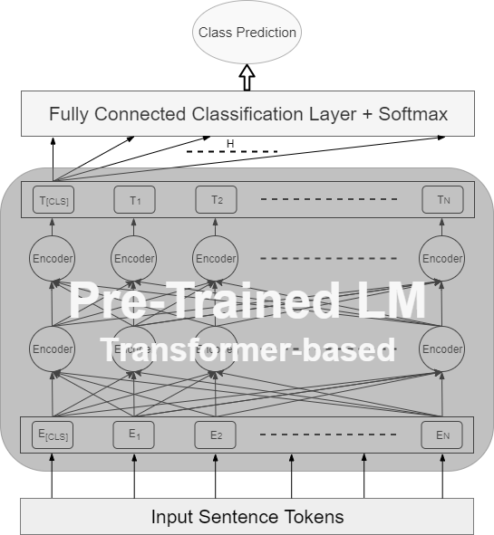
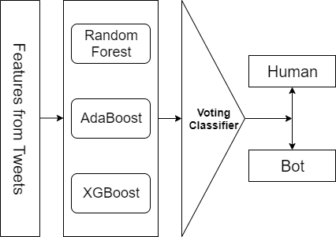
Proposed Methods
Fake News and News Domain:
Pre-trained Transformer-based language models (Deep Learning) (BERT, XLNET, RoBERTa…)
Feature-based
Twitter Bots:
Feature Engineering from the text (extract features that are commonly present in bot tweets)
Feature Engineering the tweet’s metadata
Ensemble classifier
Notes:
This pre-trained ULM will be used as a starting point for training any text classification task (aka. Fine-tuning) including, but not limited to, sentiment analysis.
Show how and where we are addressing the gaps in BERT
Show at the high level the two approaches that you are following in the paper
Show big picture first.
Then show details of how you developed the Arabic ULMs
Focus on what you did as unique
PUT MADAMIRA here

Slide 14
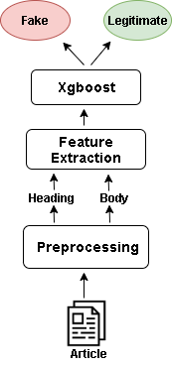
Methodology - Fake News Detection
Contest winning feature-based model from paragraphs :
Preprocessing:
Separate headings from the body of each article
Remove extra empty spaces, newlines, non-alphanumeric characters,
character words.
Lower case, tokenize, lemmatize
Feature extraction:
similarity features between the heading and the body of each article :
[n-grams, char-grams, and common words tokens]
Similarity between the title of an Article and the title of the top-5 search results
Lexicon based features : assertive verbs, factive verbs,
[hedges, implicative, report verbs, bias, and subjectivity from each article]
Notes:
Examples for Lexicon based features

Slide 15
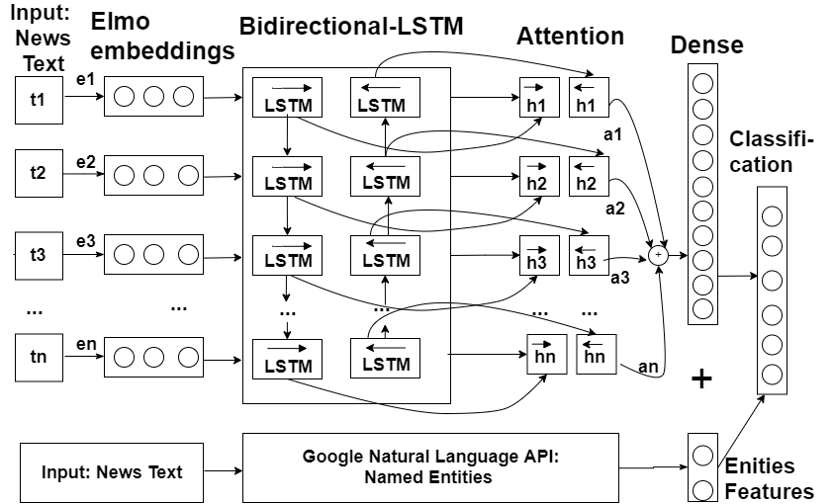
Methodology (News domain detection)
Contest winning feature-based model:
Features:
hand-crafted features from using Google Cloud Natural Language API
Named Entities distribution
ELMO word-embeddings with Bi-Directional LSTM with Attention
Notes:
Examples for Lexicon based features

Slide 16
Methodology - Fake News and News Domain Detection
Pre-Trained Transformer-based model :
Detect stylistic differences
Deep understanding of natural language and its underlying semantics
Pre-trained on huge corpora
Require less-data to converge
SOTA on multiple NLP tasks

Slide 17
Methodology (Twitter Bots detection)
Contest winning feature-based model from paragraphs :
Feature extraction: from tweets’ metadata and tweets’ text
Duration between account creation and tweet date
Number of Retweets
Number of Favorites
Followers to Follow Ratio
Existence of media
If the user is verified
Location availability
Existence of a bio
Presence of a website in the user’s metadata
The number of hashtags in the tweets
The existence of a direct quote (the tweet contains a “:”)
The number if emojis in the tweet
If the tweet is a re-tweet
Existence of a link in the tweet
Voting classifier that is composed of a combination of
random forest, AdaBoost and XGBoost was developed.
Notes:
Examples for Lexicon based features

Slide 18
Experiments and Evaluation

Slide 19
Datasets
Article paragraphs (English): 6 categories (Politics, Business, Sports, Entertainment, Technology, and Education).
Training data: 384 articles (192 fake and 192 legitimate)
Validation: 48 articles (24 fake and 24 legitimate)
Testing: The final submission consisted of 45 articles.
Tweets (Arabic): random sample of the Arabic hashtag #السعودية (trans: Saudiyya / Saudi) between September and August 2018
Training: 18384 tweet
Validation: 1615 tweet
Testing: 8431 tweet

Slide 20
Experiment Setup
Transformer-based models → Google’s Colab GPU environment
Other experiments were conducted on our local machines
Hyper-parameters’ details for each model were obtained through randomized grid search
Hyper-parameters details are available on our Github repo

Slide 21
Results

Slide 22
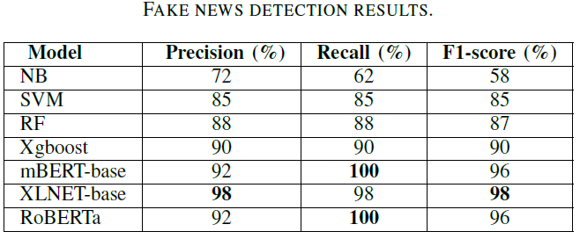
Results on Fake News Detection
While the feature-based ML achieved good results, the pre trained deep learning language models classifiers (BERT, XLNet, RoBERTa) achieved the best performance.

Slide 23
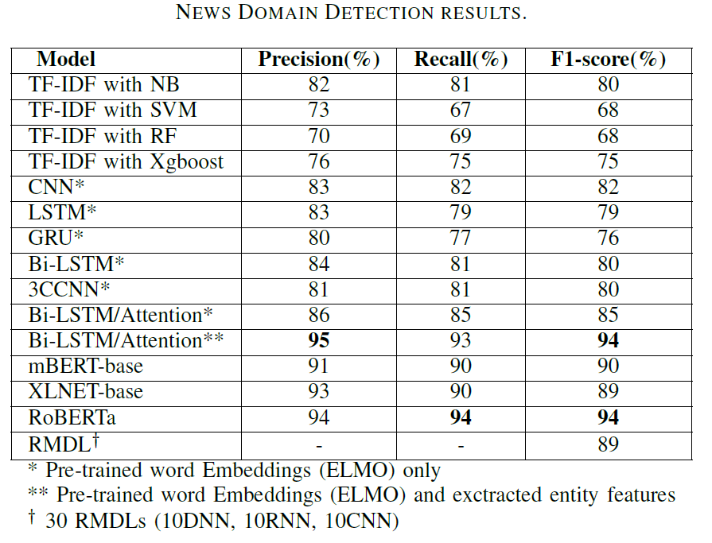
Results on News Domain Identification
Bi-LSTM with attention in combination with the hand-crafted features were able to match pre-trained language models in performance

Slide 24
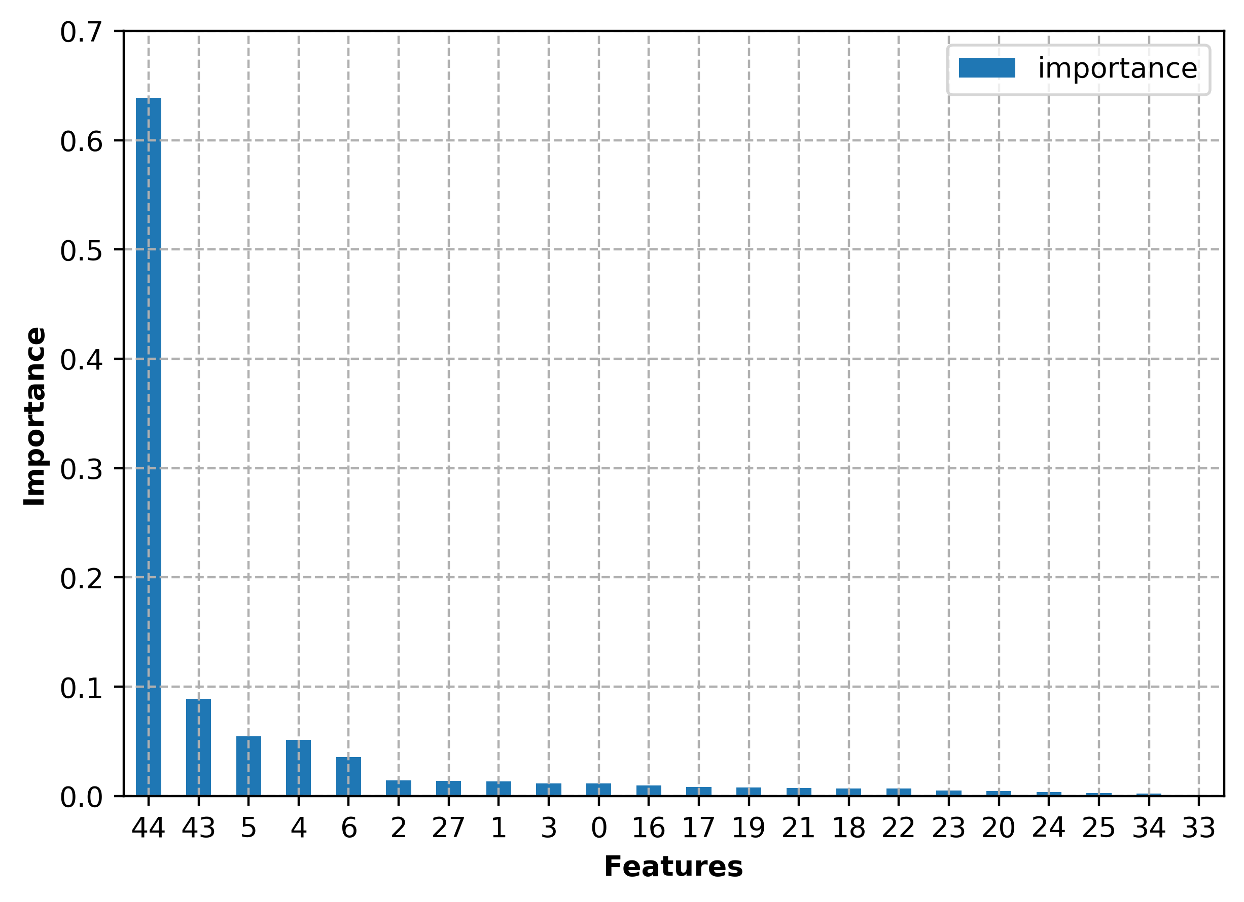
Results
Fake News (Articles)
Feature Ranking for Fake News: cosine similarity between the title’s embedding and corresponding google searches showed the highest impact.
The named entity features provide a significant performance improvement of 10% for the Bi-LSTM with attention model
Additional analysis of the 4 classification errors, 3 articles were found to be “mislabeled”
Twitter Bot Detection
The best features subset: duration between account creation and tweet date, existence of a link in the tweet if the user is verified, the existence of a direct quote, and the number of favorites
Duration between account creation and tweet date alone: 96% with random forest classifier.
Tweets with direct quotes showed a high correlation with the account being flagged as bot.
Notes:
What about the claims that the new model does a better representation than BERT? Where do we see that?

Slide 25
Conclusion and Future Work
We presented the state-of-the-art models that achieved first place in an international fake news competition.
For fake news (Articles), we concluded with state-of-the-art approach based on XLNET.
For news domain detection, a hybrid approach composed of frequency distribution of named entities concatenated with ELMO word embeddings
For twitter bot detection system, the system is composed of features extracted from news tweets combined with the news tweets’ metadata.
As a future work, we suggest improving fake news performance by adding features from fact-checking websites
Combining information about news from other sources: videos and speech (multimodality)

Slide 26
Thank You Q&A

Slide 27
References
https://www.novinite.com/articles/195661/Maria+Gabriel%3A+75+of+Young+People+Do+Not+Recognize+Fake+News
S. Vosoughi, D. Roy, and S. Aral, “The spread of true and false news online,” Science, vol. 359, no. 6380, pp. 1146–1151, 2018.
R. Baly, G. Karadzhov, D. Alexandrov, J. Glass, and P. Nakov, “Predicting factuality of reporting and bias of news media sources,” arXiv preprint arXiv:1810.01765, 2018
V. Perez-Rosas, B. Kleinberg, A. Lefevre, and R. Mihalcea, “Automatic ´ detection of fake news,” in Proceedings of the 27th International Conference on Computational Linguistics, 2018, pp. 3391–3401.

